Slide 1
Database Design Chat 004
What does the customer actually want?

Slide 2
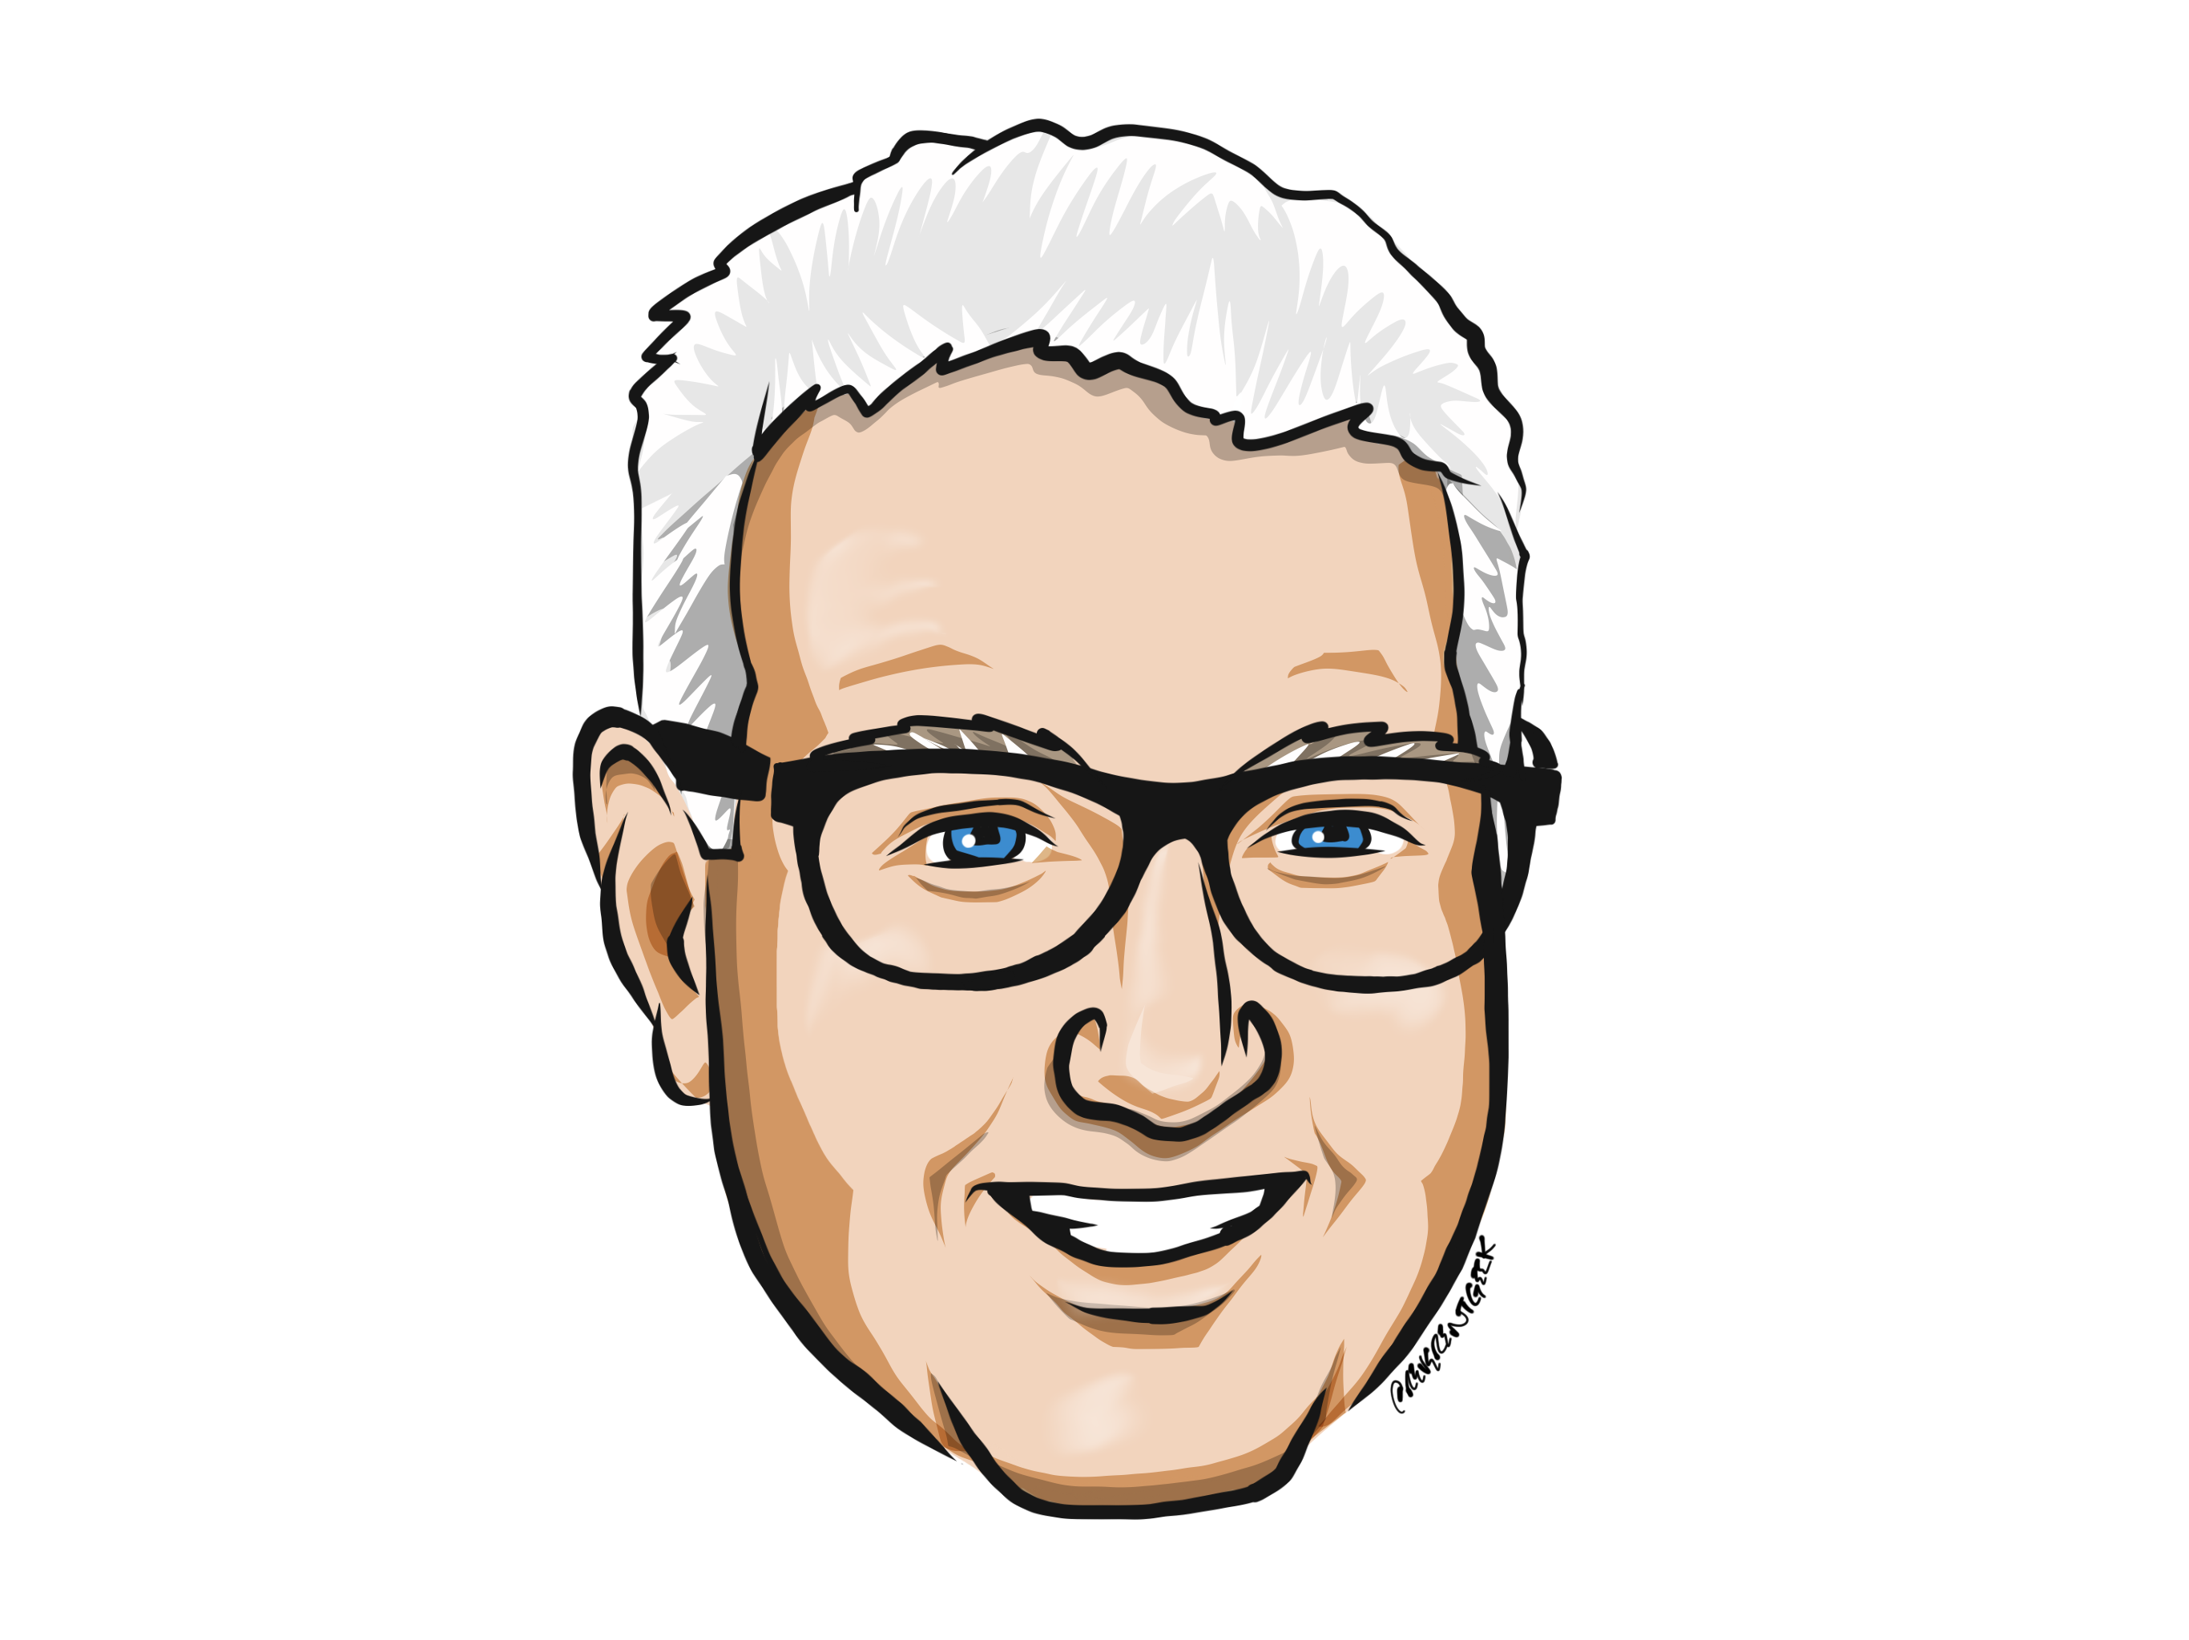
Louis Davidson (drsql)
https://linktr.ee/drsql

Slide 3
Requirements
In episode 1, correctness was defined as meeting a specification
This specification grows out of requirements
The tricky part of requirements is getting into the head of the customer

Slide 4
Business Analyst have a hard job
Whoever gathers requirements must be:
Knowledgeable enough about the business to know what they are saying
Humble enough to not force their own ideas on the customer
Strong enough to press unwilling customers for details
Precise enough to specify the customers needs in a non-ambiguous manner
Calm enough not to rip the head off of a customer that won’t help out
Or in other words, practically a saint

Slide 5
Requirements are early Test Plans
Through the rest of the development lifecycle
Design
Implementation
Test
You will base everything off of the requirement and change them as needed
In all examples in this series, I will start out with concise requirements

Slide 6
Agile versus Analysis Paralysis
You don’t need every requirement for a system to start
Agile methodologies break down work into small chunks
Someone should understand the general destination

Slide 7

Requirements are like Family Vacation Plans
Requirements
If everyone decided on Lake Eerie (instead of Erie), then everyone is to blame

Slide 8
Until next time…
Remember that correctness is the only goal worth achieving.
How you measure what is actually correct starts with requirements
It is the hardest part of almost any project
How to know when you have enough leads into next episode’s subject
Good enough

Slide 9
Questions?
If you have questions, you can:
Comment on YouTube
Email drsql@hotmail.com
Message me on Twitter at drsql
Contact me anywhere on https://linktr.ee/drsql
I may add an episode to discuss or reply directly

